Slide 1

IMPLEMENTATION OF VHDL PROGRAMS USING MODELSIM AND QUARTUS PRIME II
K S SCHOOL OF ENGINEERING & MANAGEMENT, BENGALURU-560109
DEPARTMENT OF ELECTRONICS & COMMUNICATION ENGINEERING
INTERNSHIP /PROFESSIONAL PRACTICE
ON
Presented By
1KG16EC098
SPANDANA S
Internship Guide
MRS.SHANTHALA G M
Associate. Prof,ECE, KSSEM

Slide 2
Outline
Introduction About Company / Organization
Work assigned
Work Completed
Conclusion
Department of Electronics & Communication Engineering, KSSEM

Slide 3

Introduction
Bharat Heavy Electricals Limited (BHEL) owned and founded by the Government of India, is an engineering and manufacturing company based in New Delhi, India. Established in 1964, BHEL is India's largest power generation equipment manufacturer.
BHEL was converted into a public limited company.
Over time, it developed the capability to produce a variety of electrical, electronic and mechanical equipment for all sectors, including transmission, transportation, oil and gas and other allied industries
Department of Electronics & Communication Engineering, KSSEM

Slide 4
FUNCTIONS:
BHEL is engaged in the design, engineering, manufacturing, construction, testing, commissioning and servicing of a wide range of products, systems and services for the core sectors of the economy, viz. power, transmission, industry, transportation, renewable energy, oil & gas and defence.
It has a network of 17 manufacturing units, 2 repair units, 4 regional offices, 8 service centres, 8 overseas offices, 15 regional centres, 7 joint ventures, and infrastructure allowing it to execute more than 150 projects at sites across India and abroad. The company has established the capability to deliver 20,000 MW p.a. of power equipment to address the growing demand for power generation equipment.
Department of Electronics & Communication Engineering, KSSEM

Slide 5
ABOUT ELECTRONICS DIVISION
The Electronics Division (EDN) of BHEL was formed in 1976, mainly to
establish a strong base in the areas of power and industrial electronics, and
supplement the company's pioneering efforts in power generation,
transmission, industry, and transportation.
Products of BHEL in Electronics Division (EDN) are
Automation and Power Electronics System.
Semiconductor and Photovoltaic Systems.
Defence electronics.
Software system solutions.
Service offered.
Department of Electronics & Communication Engineering, KSSEM
Notes:
Service offered

Slide 6
Work Assigned
The work during the internship revolved around configuring, modifying and programming board to meet the specific requirements of the project that was underway at the time.
We had to develop a VHDL code using “ModelSim” software and test the code and load it to the “Spartan FPGA kit” using “Quartus Prime” software.
The process started with learning the basics of VHDL coding, writing and implementing smaller codes. Once we were thorough with the basics of programming language, we learnt about the software we would use for the project.
We studied many articles about the software to learn the , steps to use the software, applications and lot more which was required for our project.
Department of Electronics & Communication Engineering, KSSEM

Slide 7
Work Assigned
Software Used:
ModelSim
Quartus prime II
Hardware Used:
Spartan FPGA kit
ARM DS 5 microcontroller
.
Department of Electronics & Communication Engineering, KSSEM

Slide 8
Work Completed
Methodology
We have followed few steps to achieve our goals mentioned in the objective. The methodology for this internship had two parts.
Studying and learning the concepts required.
In this part of methodology, we first learnt about the VHDL code required for the project then we learnt few things about the software, tools, kit we would use for the completion of the project assigned for us.
Application using Software and Hardware.
Here, we used the code we had theoretically written and simulated the code using ModelSim software and tested for errors and generated the waveforms. We also implemented the code later in Quartus Prime II for further use in the project and also we have dump the code to kit.
Department of Computer Science & Engineering, KSSEM

Slide 9
Execution
ModelSim
ModelSim is well suited to simulate digital components based on the hardware description languages VHDL (Very High Speed Integrated Circuits Hardware Description Language) and Verilog.
Department of Electronics & Communication Engineering, KSSEM

Slide 10
INTEL QUARTUS PRIME:
Intel Quartus Prime is programmable logic device design software produced
by Intel prior to Intel's acquisition of Altera the tool was called Altera
Quartus II.
Quartus Prime enables analysis and synthesis of HDL designs, which enables
the developer to compile their designs, perform timing analysis,
examine RTL diagrams, simulate a design's reaction to different stimuli, and
configure the target device with the programmer.
Quartus Prime includes an implementation of VHDL and Verilog for hardware
description, visual editing of logic circuits, and vector waveform simulation.
Department of Electronics & Communication Engineering, KSSEM

Slide 11
Spartan-6 FPGA
Spartan-6 FPGA SP605 Evaluation Kit offers all the basic components for developing broadcast, wireless communications, automotive, and other cost- and power-sensitive applications that require transceiver capabilities in one package.
The SP605 evaluation kit provides integration of hardware, software, intellectual property (IP), and pre-verified reference designs so development can begin right out of the box.
Spartan-6 FPGA connectivity kit is designed for quick and efficit development of connectivity system.
The connectivity kit is an easy-to-use connectivity development and demonstration environment that uses spartan-6 family.
Department of Computer Science & Engineering, KSSEM

Slide 12
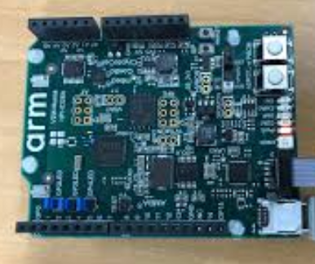
ARM DS 5
This is a list of development tools for 32-bit ARM Cortex-M based microcontroller, which consists of Cortex-M0, Cortex-M0+, Cortex-M1, Cortex-M3, Cortex-M4, Cortex-M7, Cortex-M23, Cortex-M33 cores.
The ARM Cortex-M is a group of 32-bit RISC ARM processor cores licensed by Arm Holdings.
Department of Electronics & Communication Engineering, KSSEM

Slide 13
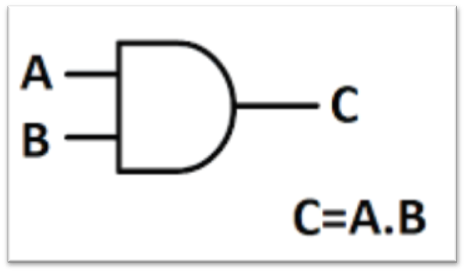
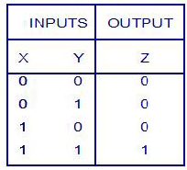
Technical Outcome
In Modelsim Simulation for AND GATE
Symbol Truth Table
Department of Electronics & Communication Engineering, KSSEM

Slide 14
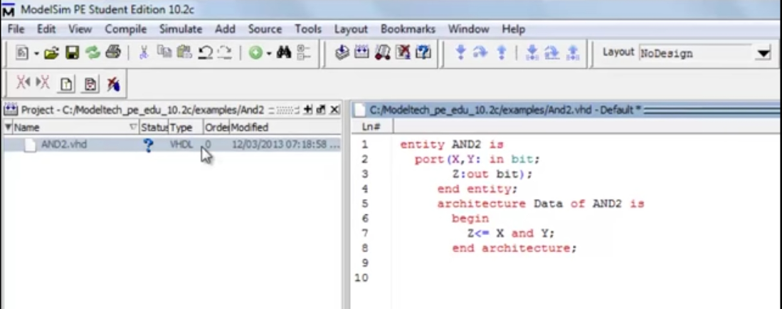
Department of Electronics & Communication Engineering, KSSEM

Slide 15
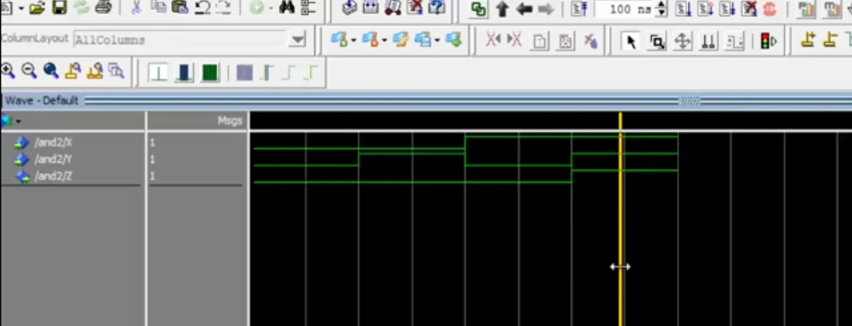
This is the timing diagram output in modelsim for AND Gate
Department of Electronics & Communication Engineering, KSSEM

Slide 16
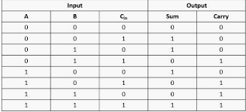
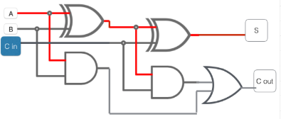
Technical Outcome
In Quartus Prime II for Full Adder
Design Truth Table
Department of Electronics & Communication Engineering, KSSEM

Slide 17
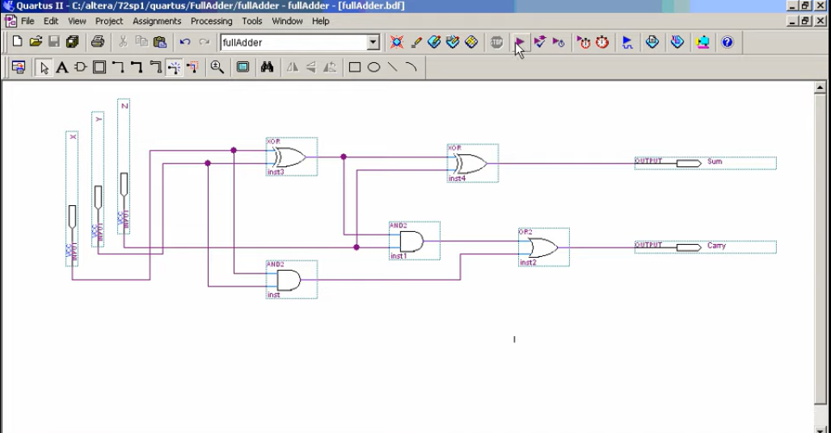
This is user input RTL Design of Full Adder
Department of Electronics & Communication Engineering, KSSEM

Slide 18
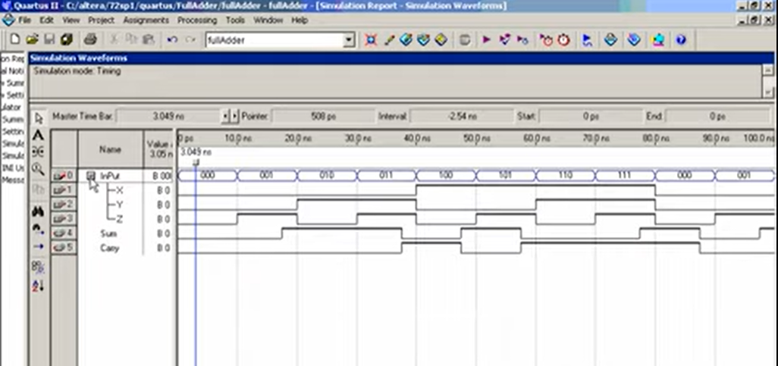
This is output for the RTL design of Full Adder
Department of Electronics & Communication Engineering, KSSEM

Slide 19
Conclusion
We learnt how to perform a functional simulation using a user-written VHDL code, as well as a detailed timing simulation. For the timing simulation, we used a simple method to generate design description using Altera Quartus II CAD software, which includes the low-level design details and circuit delays.
There are more advanced options for simulation available in ModelSim software. They can help automate and speed up the simulation of larger more complex designs.
Department of Electronics & Communication Engineering, KSSEM

Slide 20


